Slide 1
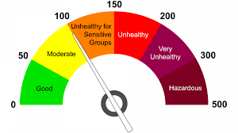
Air Quality
Team Members
Yukie Kajita
Andrea Pappa
Portia McGriff
Graham Endean

Slide 2

Introduction
Air quality is more important today than ever before.
Referenced as an indicator of our environmental health
Correlated to individual health outcomes in certain geographic regions
The focus of our project is identifying the places in the United States with the best air quality.

Slide 3
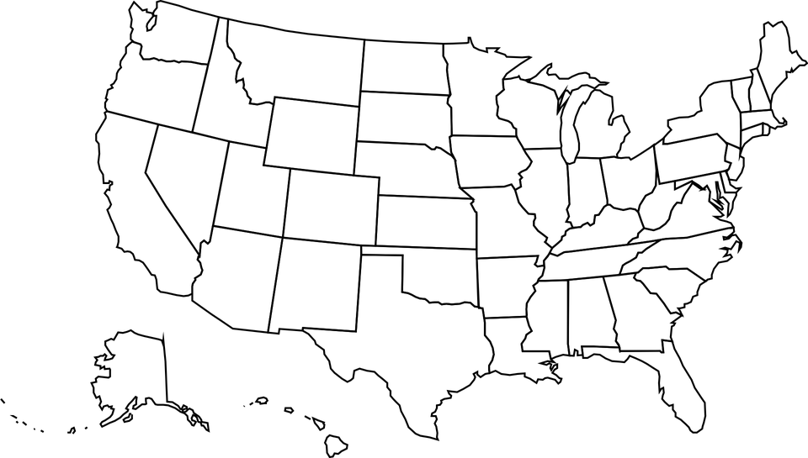
Project Focus
Data Source:
EPA Outdoor Air Quality
Date Range: Jan - Dec 2019
Where can we find the best air quality in the United States?
Are the outcomes surprising?
What additional insight can we gain from the data collected?

Slide 4

Agenda
File Structure & Plan
Data Analytics & Testing
Visual Demonstration & Explanation
Conclusion

Slide 5
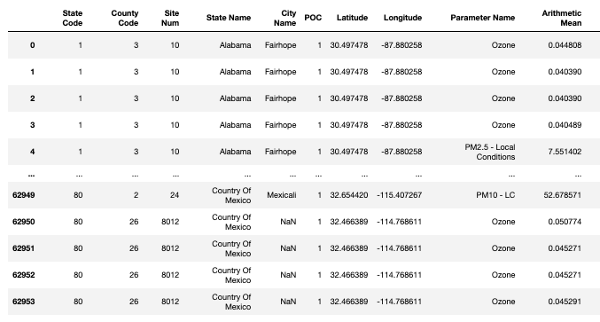
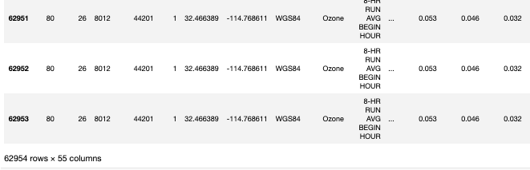
File Structure & Plan
ETL
Extract:
CSV File from EPA
Transform:
w/ Python Pandas
- Jupyter Notebook
Load: SQLite
w/ Python SQLAlchemy
- Jupyter Notebook
Data Frame 1: Sample Locations Map
Data Frame 2: Graphs to show each state’s mean of Ozone and PM2.5

Slide 6
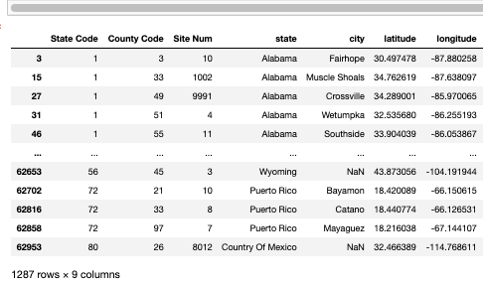
File Structure & Plan
ETL
Data Frame 1: Sample Locations Map
Extract:
CSV File from EPA
Transform:
w/ Python Pandas
- Jupyter Notebook
Load: SQLite
w/ Python SQLAlchemy
- Jupyter Notebook

Slide 7
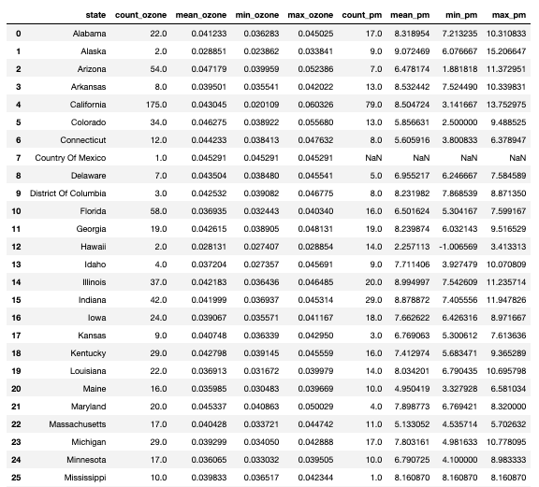
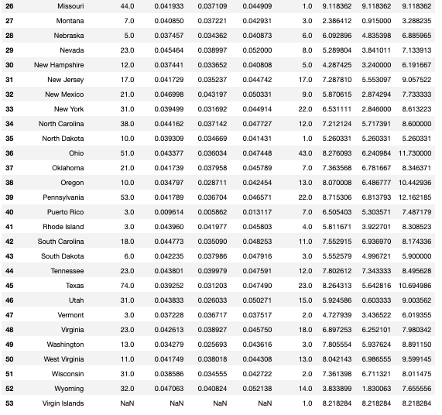
File Structure & Plan
ETL
Data frame 2: Graphs to show each state’s mean of Ozone and PM2.5
Extract:
CSV File from EPA
Transform:
w/ Python Pandas
- Jupyter Notebook
Load: SQLite
w/ Python SQLAlchemy
- Jupyter Notebook

Slide 8
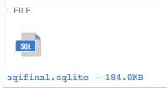
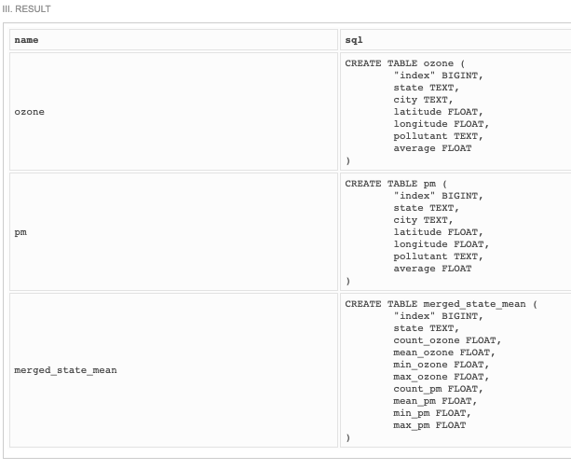
File Structure & Plan
ETL
Extract:
CSV File from EPA
Transform:
w/ Python Pandas
- Jupyter Notebook
Load: SQLite
w/ Python SQLAlchemy
- Jupyter Notebook

Slide 9
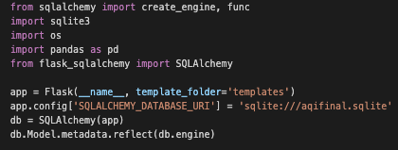
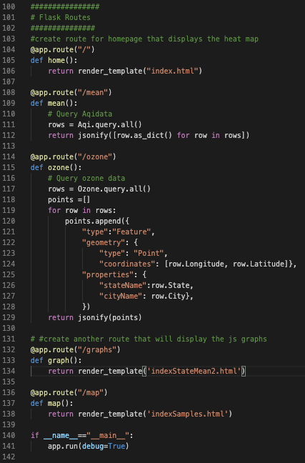
File Structure & Plan
ETL
app.py - Flask, SQLAlchemy
- Access to SQLite DB
- Pass data to Javascript
- Connect to HTML file & Website
Extract:
CSV File from EPA
Transform:
w/ Python Pandas
- Jupyter Notebook
Javascript
HTML
CSS
Load: SQLite
w/ Python SQLAlchemy
- Jupyter Notebook
1: Sample Locations Map
- Marker Cluster Group Satellite Base Map w/ Leaflet
2: Bar Graphs with Ozone and PM2.5 Means for Each State
- myChart.js w/ Dropdown Chart Updates Option

